Slide 1
Exploratory Data Analysis (EDA)
A deep dive into fare trends and insights Made By: Mohammed Yasser
Zeina Ahmed
Mayar Adel

Slide 2
Introduction
This project aims to analyze fare data to identify trends, patterns, and insights.
Key aspects covered include data structure, missing values, distributions, and correlations.
The goal is to understand factors influencing fares and gain actionable insights.

Slide 3
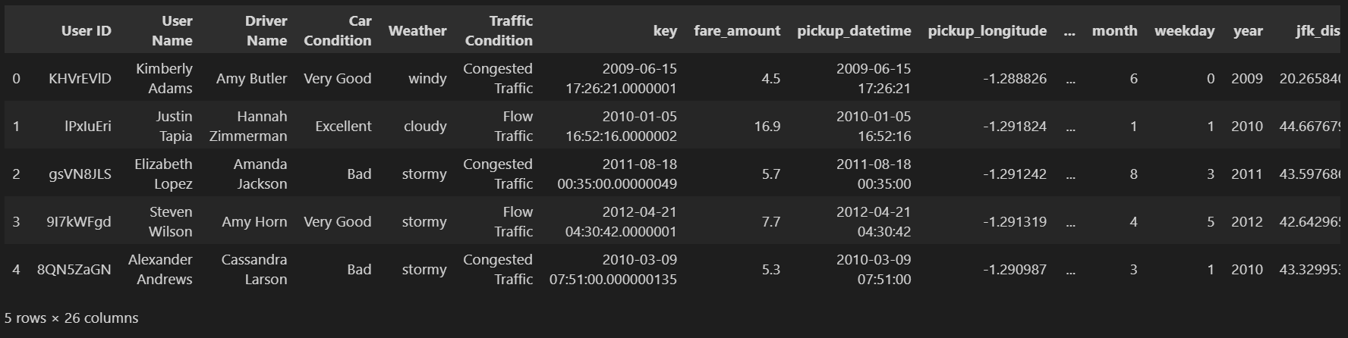
Dataset Overview
Total Rows: 500000
Total Columns: 26
Key Features:
Fare Amount: The total fare charged for the trip.
Distance: The distance travelled.
Pickup Time: The timestamp when the trip started.

Slide 4

Data Types & Missing Values
Missing Data: Some columns contain NULL values.
Approach:
Drop rows with excessive missing values.
Fill missing values using the median/mode for numerical/categorical data.
Convert data types for better processing.

Slide 5
Univariate Analysis
Studying each feature individually

Slide 6
Categorical Features

Slide 7
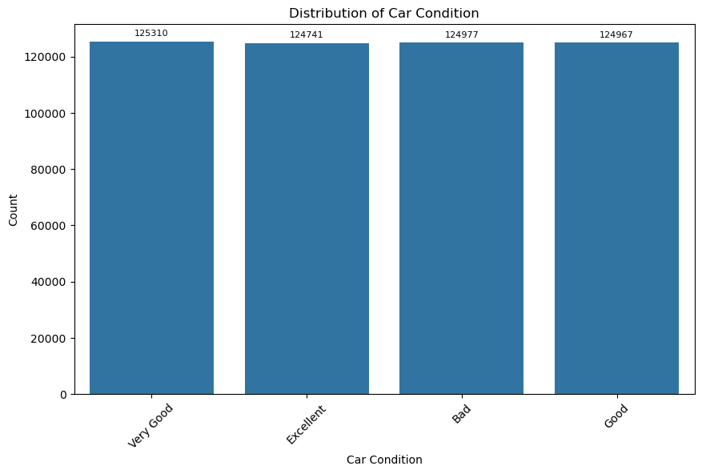

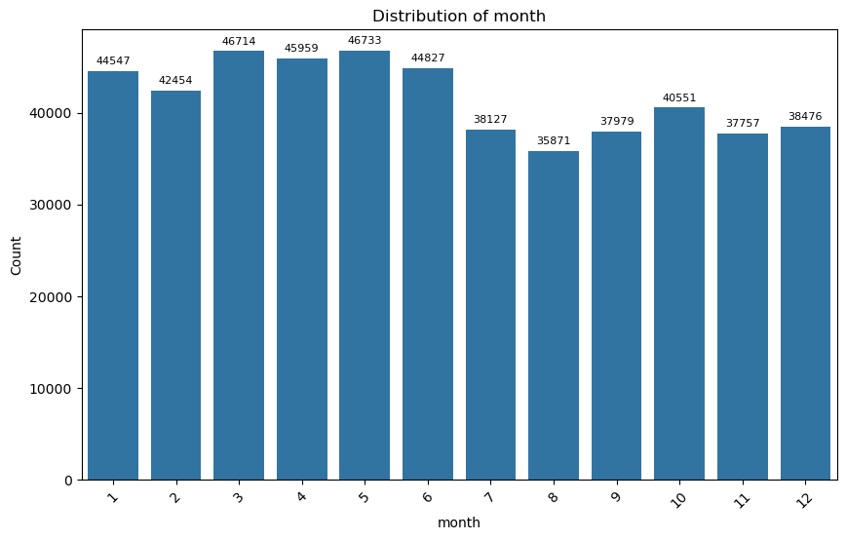
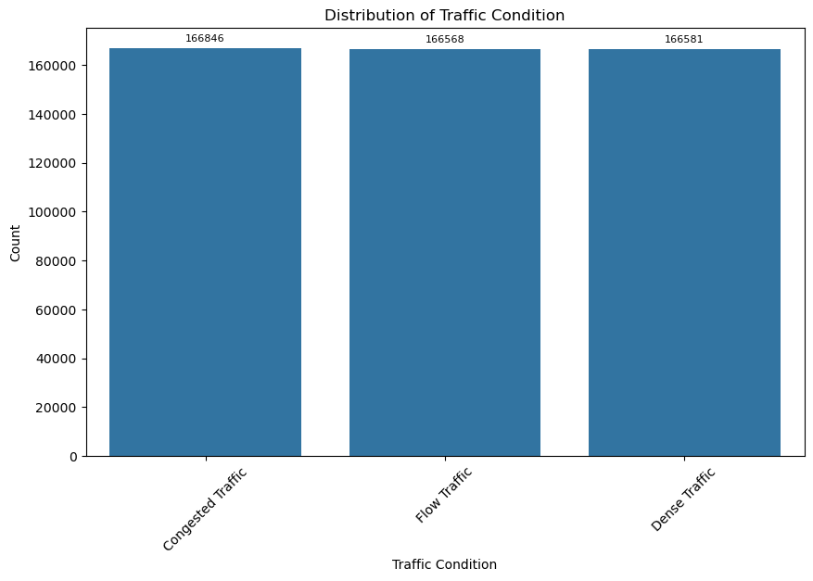
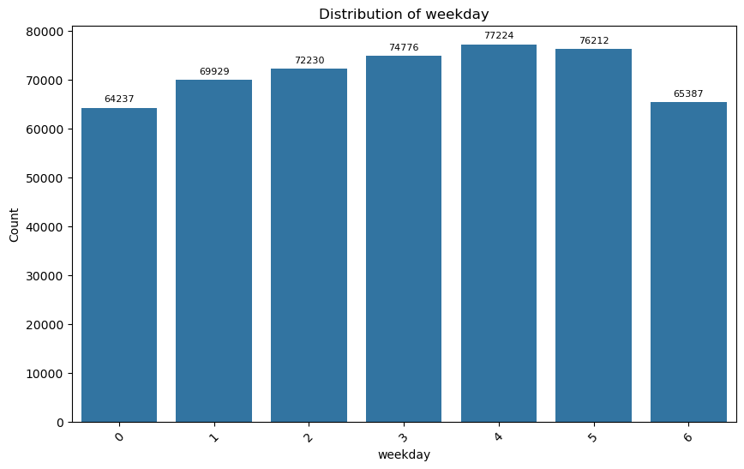
Most features has a nearly uniform distribution

Slide 8
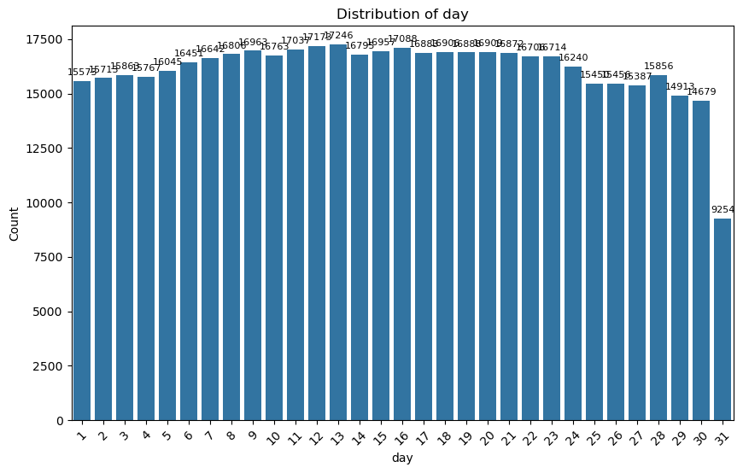
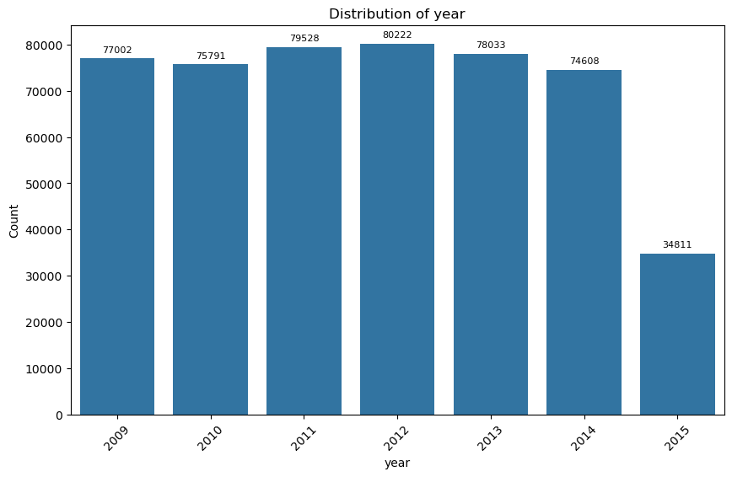
Might need resampling to compensate the smaller values

Slide 9
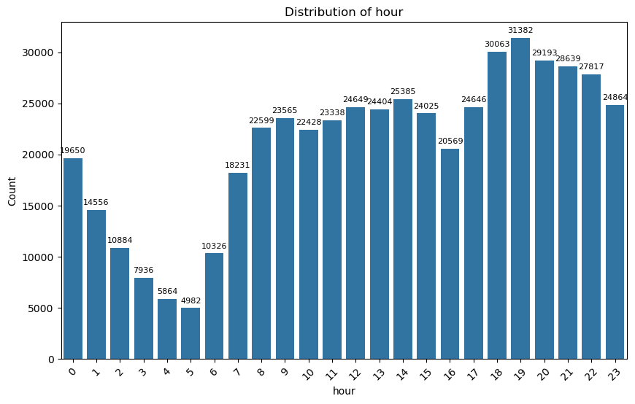
Visible treads in the number of rides each hour

Slide 10
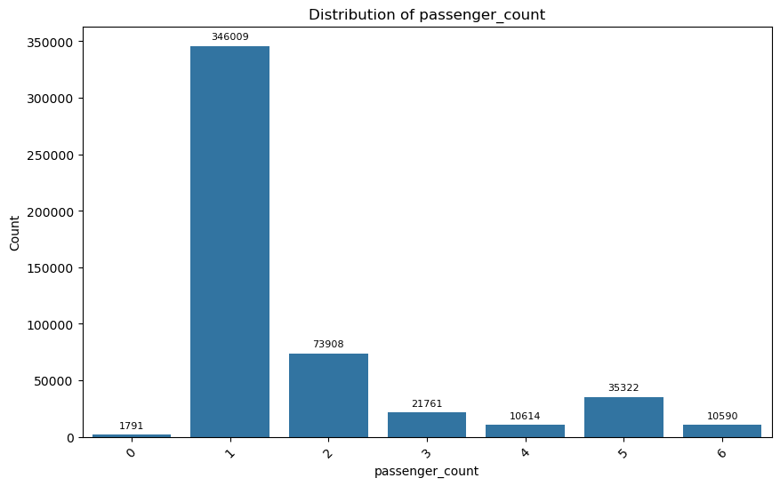
Passenger’s Count Distribution
There are 1791 rides with 0 passengers ????
To compensate we replace them with the mode which is 1 passenger

Slide 11
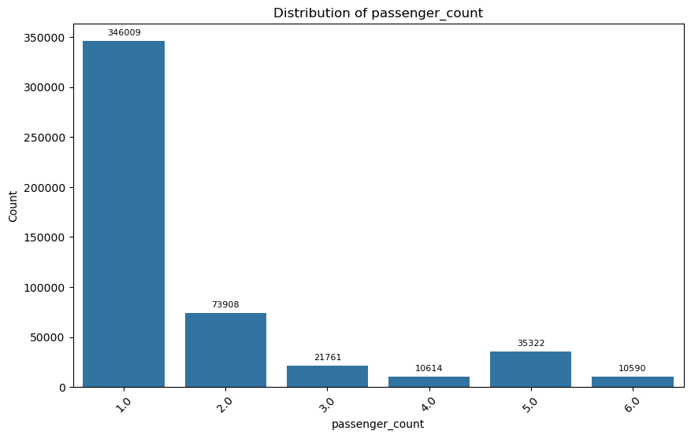
After replacing the outlier with 0
Passenger Count is Highly Skewed might need resampling.

Slide 12

Key Findings
Most Data is uniformly distributed
There is are features that might need resampling to avoid biases
Outliers exist, possibly due to incorrect data or special cases.
Certain Hours shows a visible trend.

Slide 13
Numerical Features

Slide 14
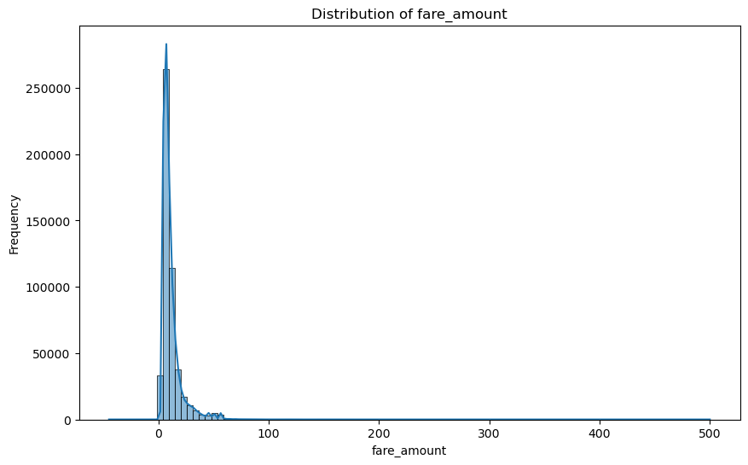
Distribution of Fares

Slide 15
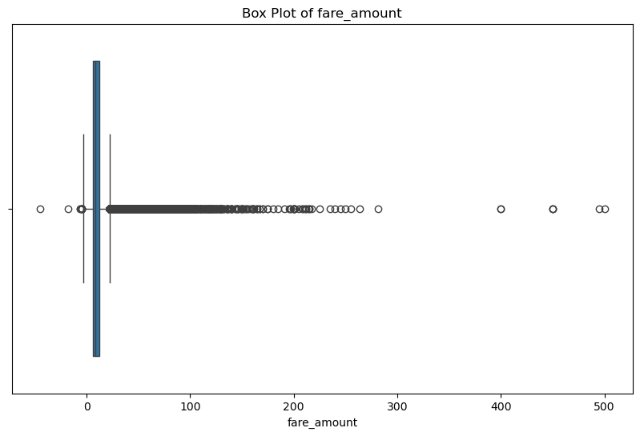
Negative Fares ???
There are 21 rides with negative fares
Assuming there are no negative fares allowed and this is a mistake
To fix we multiply each negative fare with -1 to make it positive

Slide 16
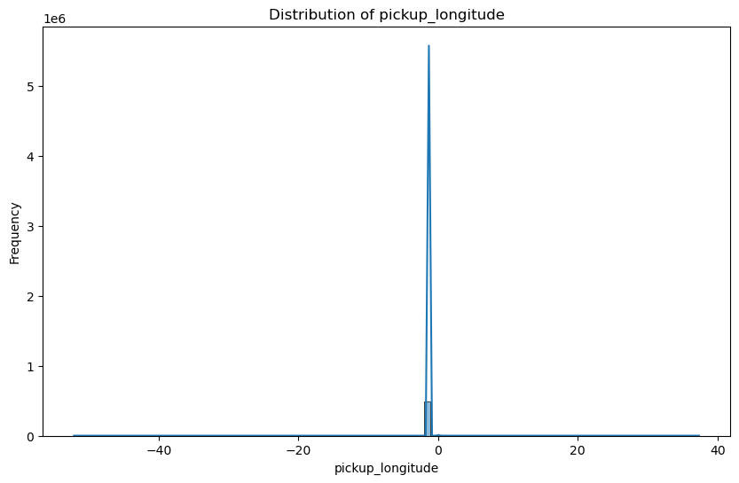
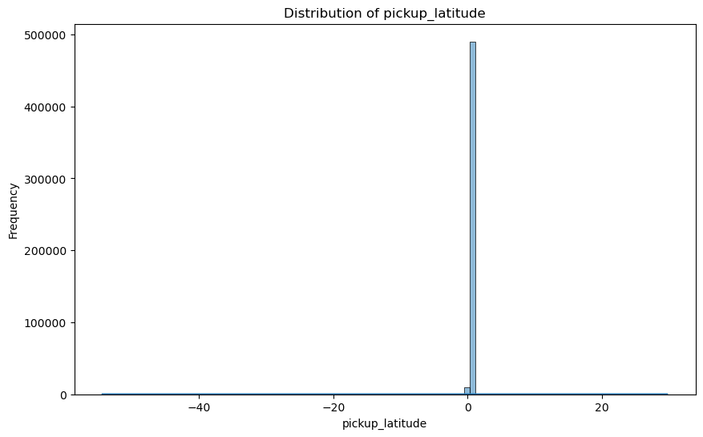
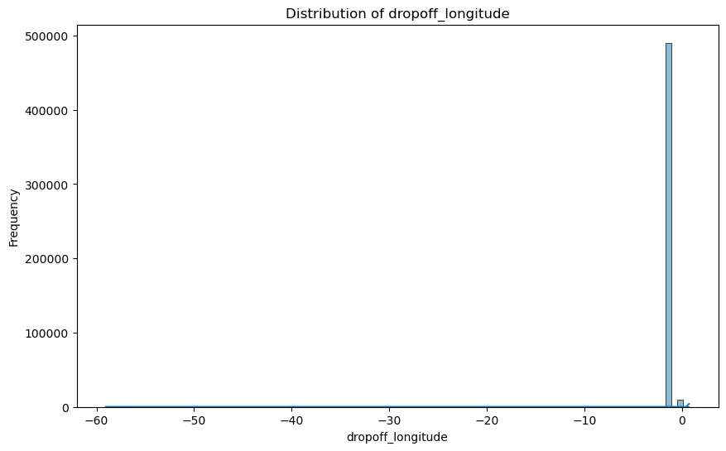
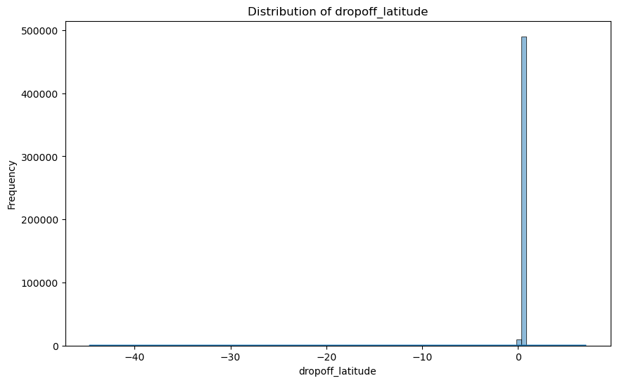
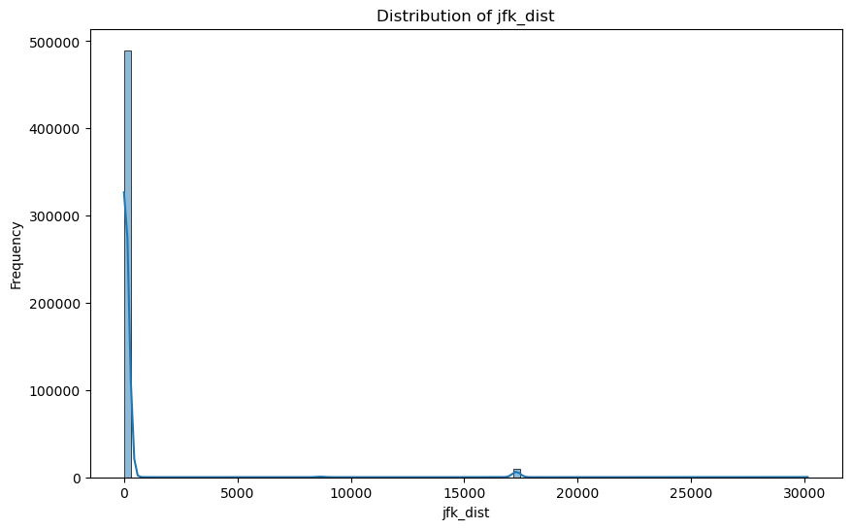

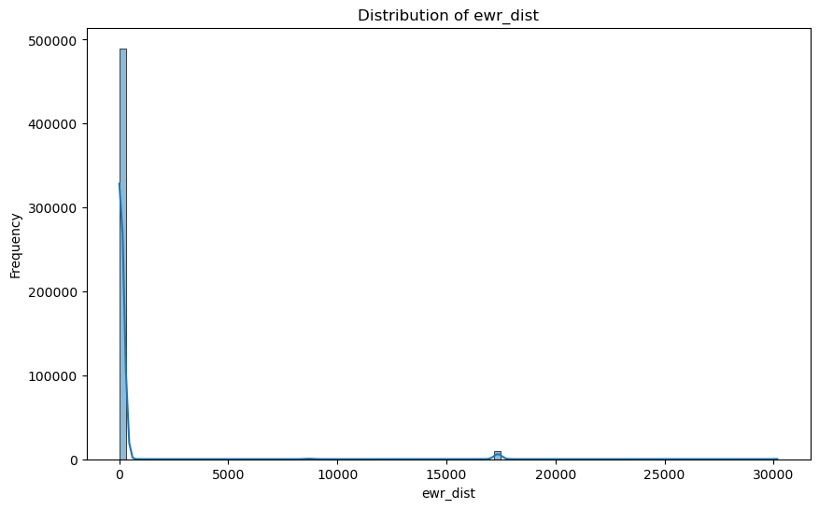


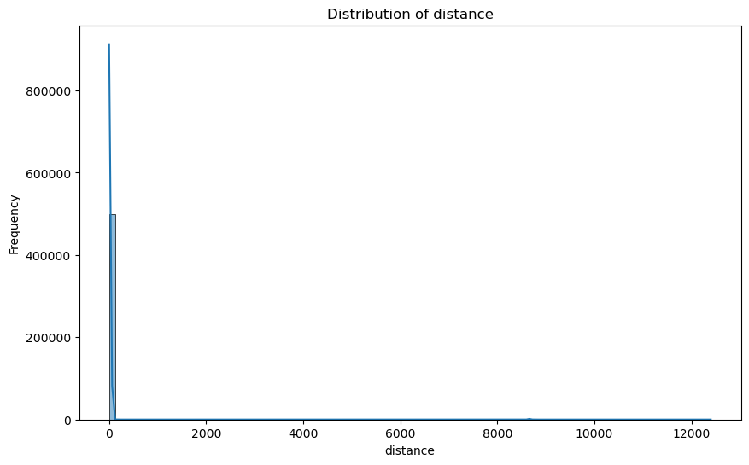
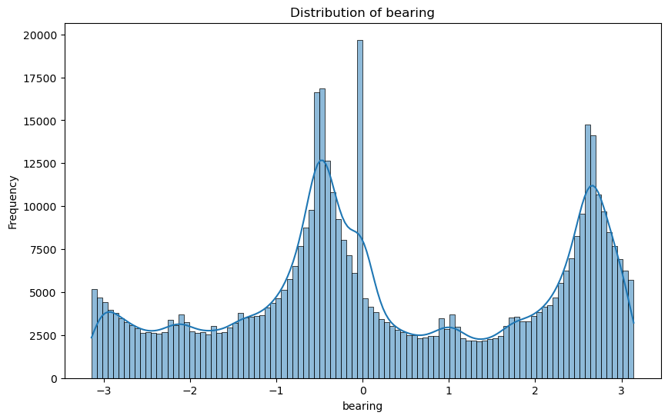
Distribution of Other features

Slide 17
Key Findings
All Numerical Features are Highly Skewed with a lot of outliers
We apply log transform to compensate the skewness with features with >1 skew
Except for the bearing feature

Slide 18
Analysis with Target Feature
How each feature affects the fare amount ?

Slide 19
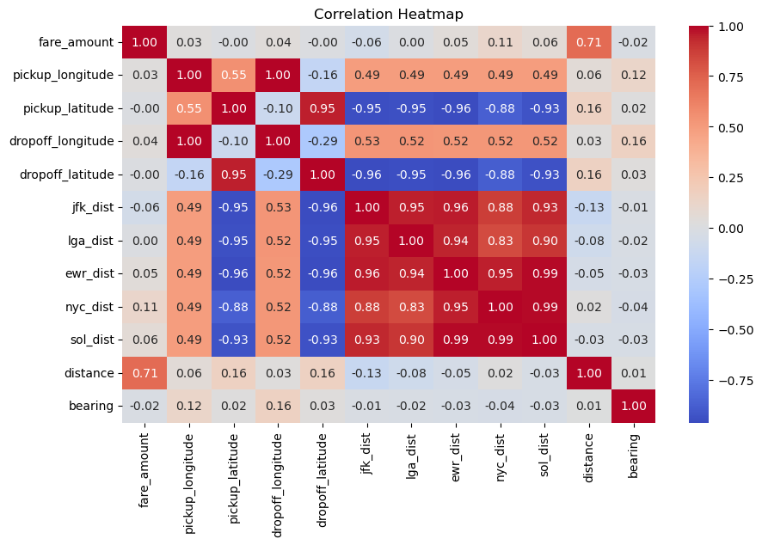
Correlation HeatMap of the features
High Correlation with certain features as distance

Slide 20
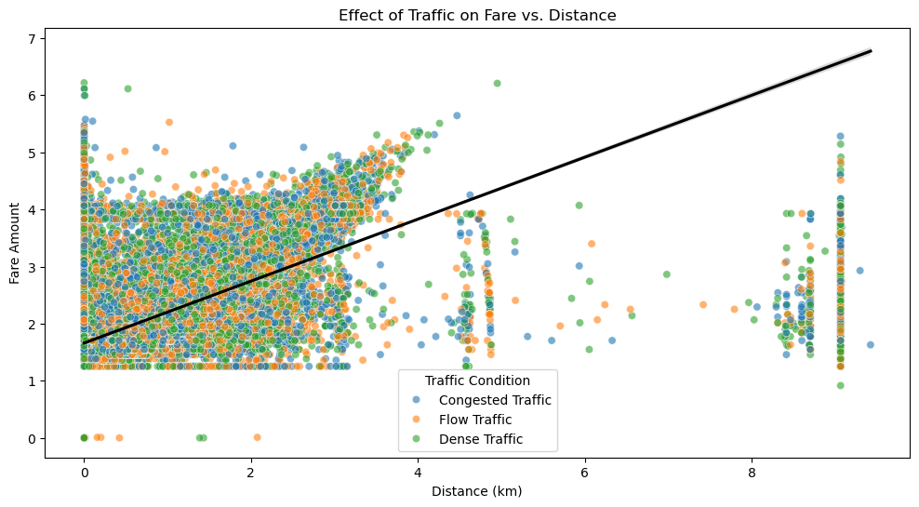
Fare vs Distance and Traffic
High Correlation between distance and fare
No affect of traffic on the fare

Slide 21
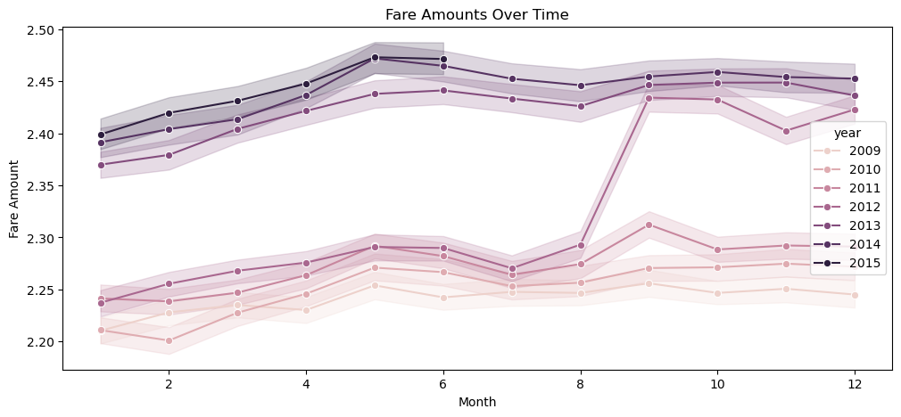
Fare Amount Over Time
Each year there is a rise in the fare amount
There is a slight increase in fare from August to September probably due to demand because of the vacation

Slide 22
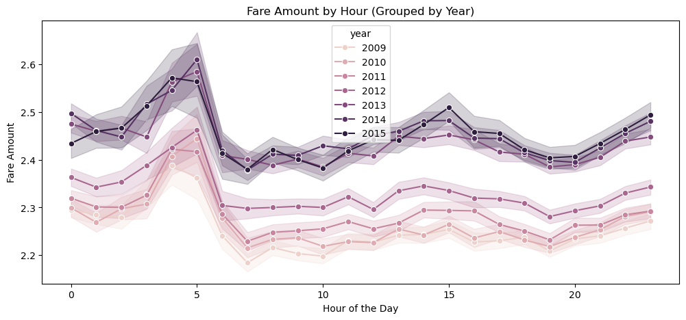
Peak fare hours
Similar Peak hours and trends each year

Slide 23
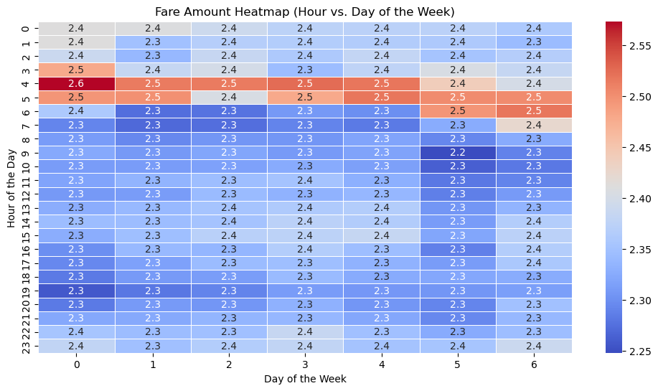
Fare Amount over the time and week
Peak Hour can change over the week

Slide 24
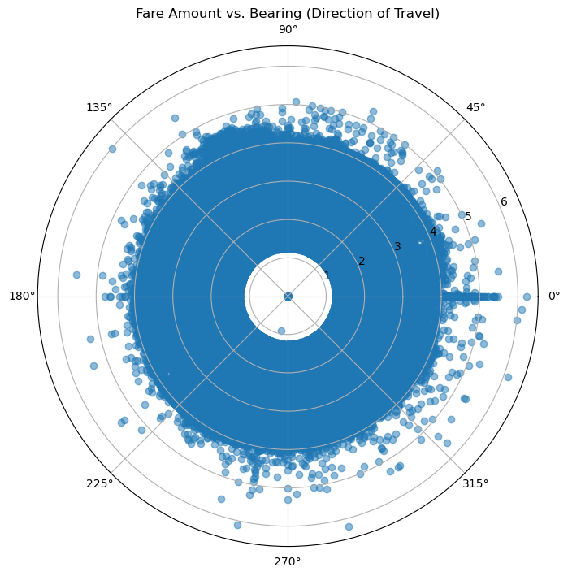
Bearing Affects Fare
No affect on bearing on the fare price

Slide 25
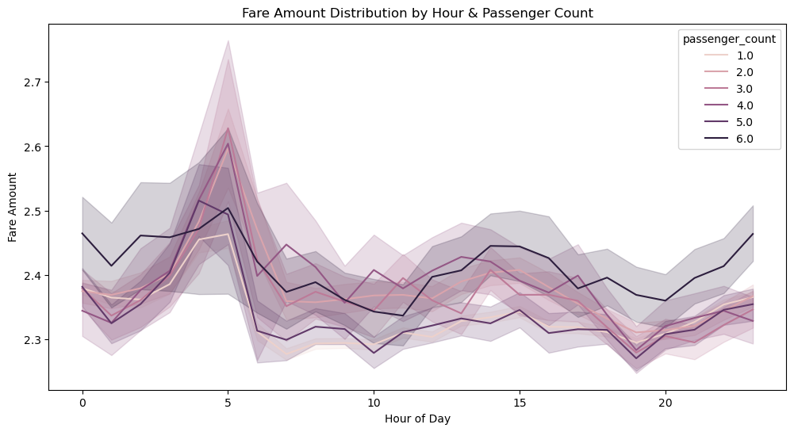
Number of people each hour
Fare prices are affected by the number of people according to the time of day

Slide 26
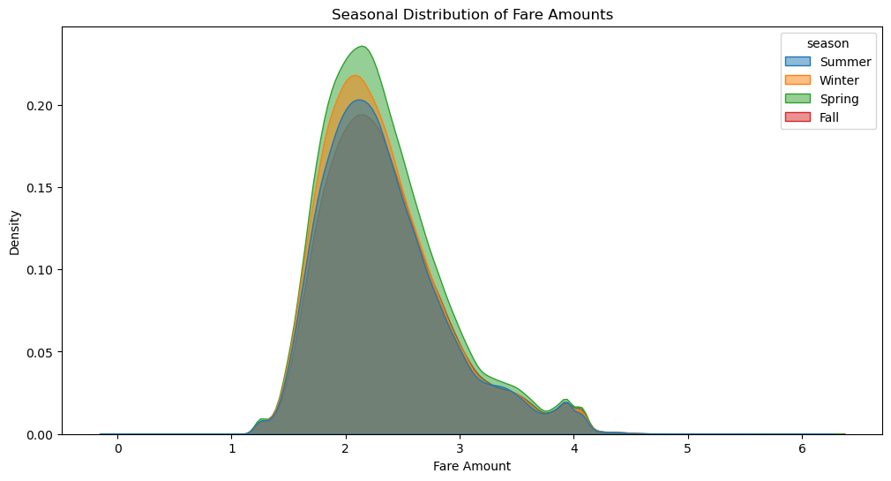
No of rides and fare each Season
The Spring season has the highest density of rides along the price.

Slide 27
Key Findings
There are certain features with high impact on the fare amount
There are certain features like bearing and weather with low impact on the fare.
Certain feature can affect the peak hour of the fares like number of people and weekday

Slide 28
Conclusion
EDA provides valuable insights into fare trends, trip patterns, and customer behavior.
The findings can help optimize pricing strategies, identify peak demand periods, and detect anomalies in fare data.
Future analysis can focus on predictive modelling to estimate fares based on trip details and detect potential outliers or fraudulent transactions..

